Slide 1

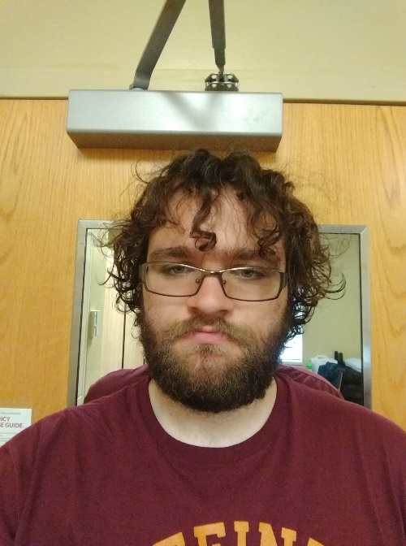
Using ProDiscover
Connor Crossen and Blake Newland

Slide 2
Questions?

